Slide 1
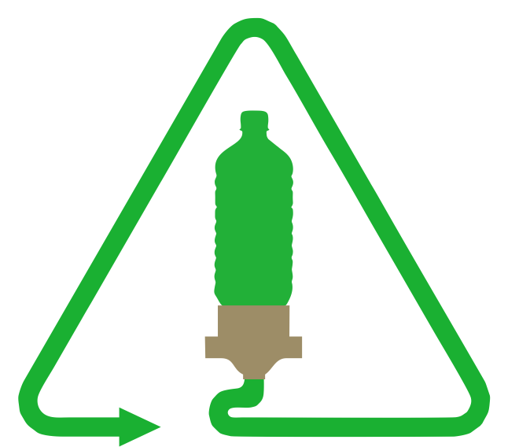
Autotruder by Green Ellipsis
Community-scale bottle to filament upcycling system

Slide 2
Green Ellipsis
Green Ellipsis Dreams of and
Designs for a Sustainable Humanity
Start-up based in St. Augustine
Engaged in Autotruder, a community-scale PET bottle upcycling system
A University of North Florida design team is automating the nozzle priming process

Slide 3
Preview
Company Overview
The Problem
One Solution
Current State
Research Projects

Slide 4
The Problem
70% of PET plastic bottles are thrown away
The time, money, and energy consumed to produce it becomes a lost resource
Carbon dioxide is emitted to replace it, costing us dearly
In America, it often doesn't make economic sense to do anything else with it.

Slide 5
One Solution
﻿Cut the cost of recycling PET bottles until we’re fools not to do it
Cut the cost of collection – leverage community groups and local recycling programs
Cut the cost of transporting – process locally to minimize transportation costs
Cut the cost of processing – design open-source, accessible, automated, community-scale bottle processing systems
Make the resulting product more valuable than the original – process the plastic into premium products
Design and manufacture these products to be recycled themselves

Slide 6
The Autotruder Part of the Solution
﻿Autotruder, a pultrusion machine, will cut the cost of processing
Design is open source so anyone can make it
Design tools are open source so anyone can modify the design files
The machine will be buildable by local talent with local tools and readily available materials
The machine will minimize labor through automation
It will be sized to fit community spaces and cottage manufacturing
Autotruder will minimize transportation costs by allowing processing to happen at the point of collection
Autotruder will maximize profitability by creating premium 3D printer filament

Slide 7
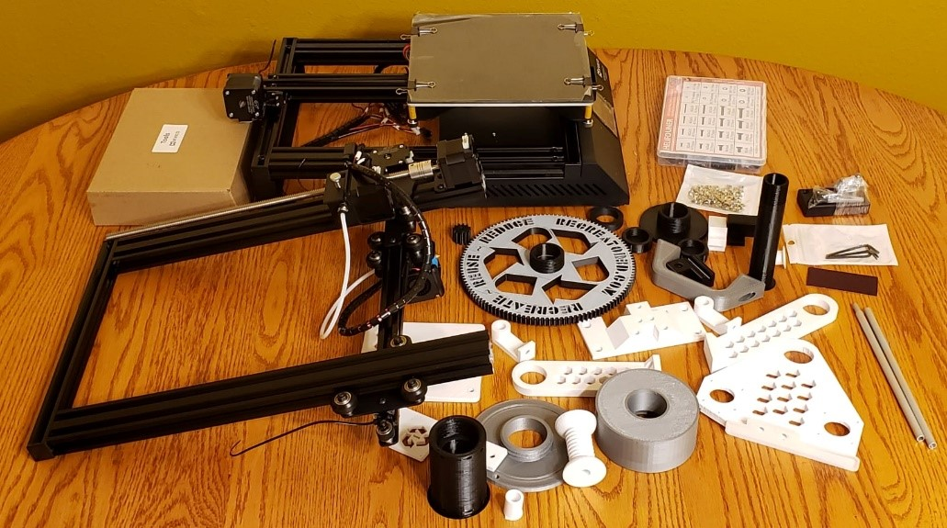
We Started With This
Josh Taylor’s Recreator3D MK3 Kit for Converting PET Bottles into 3D Printer Filament
Notes:
Christian

Slide 8

Where are We Now?
We’re right across the table from you!
Notes:
Smiley: https://commons.wikimedia.org/wiki/File:Mr._Smiley_Face.svg

Slide 9
One Solution
﻿The technical solution is an automated system that prepares polyethylene terephthalate (PET) bottles, cuts them into strips, pulls the strips through a heated die to turn it into 3D printer filament, splices filament sections into 1 kg lengths and loads them onto standard spools.
Using open source software, hardware and robotics we can cut the cost of turning bottles into 3D printer filament from $150/kg to $15/kg. At that point we can cost-effectively upcycle the plastic into a million different new products, which are still 100% recyclable.
This is a three-stage project. The goal of stage I is to characterize the state of the art and set specific improvement goals. Stage II will be a modular, iterative design and build effort targeting the specific goals identified in Stage I. The goal of Stage III is design for manufacturability, where we'll design, build, test and document the first production unit.﻿
This project is entirely open source and licensed under the Creative Commons Attribution 4.0 International (CC BY 4.0). Our thanks to Wikifactory for generously hosting this project for free. As part of our open source committment, we strongly encourage all files to be created using open source software and saved in open source formats.
Project Status. We are in Stage I. We have a Recreator 3D built and running. We need to make some modifications to it to make it more amenable to experimentation. These break down into
Firmware - managed on our RECREATOR fork on Github﻿
Hardware - need to add instrumentation, such as a filament width sensor
G-code - here in the RECREATOR folder

Slide 10
Key Terms
Polyethylene Terephthalate (ter·eph·thal·ate) [PET] - Commonly used plastic
Upcycling – the process of repurposing single-use items, such as plastic bottles, to create a product of higher quality or value
Pultrusion – a process for manufacturing plastics via pulling
Notes:
Marc

Slide 11
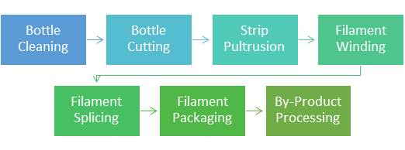
Reclamation Process
Notes:
Tony

Slide 12
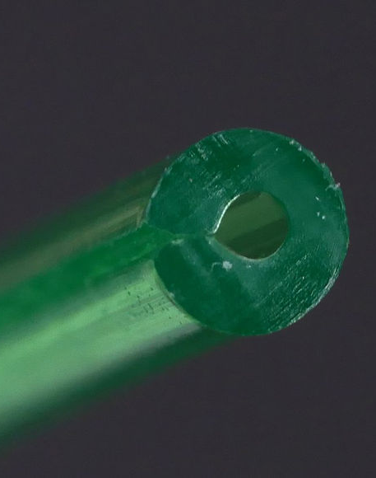
Printing with Reclaimed PET Filament
Must be extruded at 130% flow rate
Melt temp at 225-245 ℃
Bed temp 65-85 ℃
Under-cooling during printing causes embrittlement and cloudiness
Overcooling during printing causes poor layer adhesion
Notes:
Christian

